Slide 1

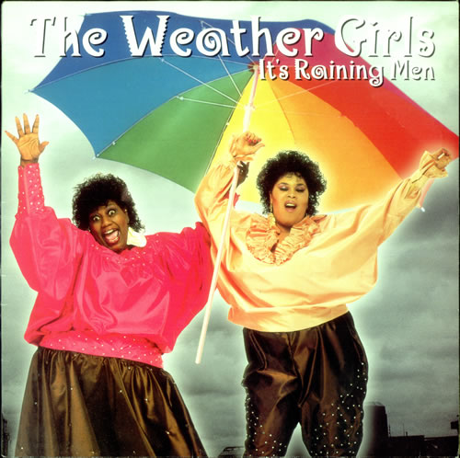

The Weather Girls
Our CCBC
Weather App

Slide 2



Initial Thoughts
We decided on the educational app brief because:
  CO2 Calculator or Shares App?
  Game?
  Educational App?

Slide 3
MVP
A user should be able to:
  View information on the weather forecast for a particular city in the UK
  Be able to interact with the page to submit a city to tailor the information displayed to that city
  Be able to display the information retrieved in a graphical format e.g. a chart
  Recommend possible activities and/or clothing depending on the weather forecast

Slide 4

Extensions
Map
Favourites
Historical Records

Slide 5
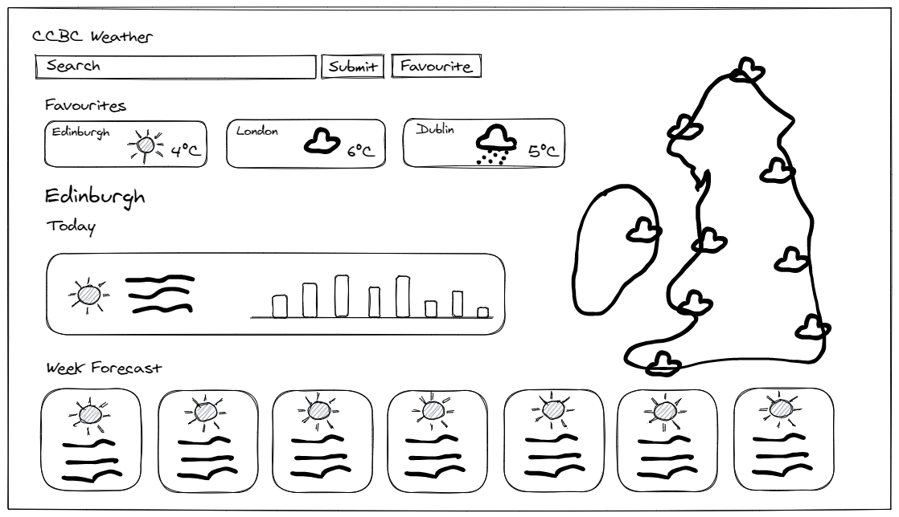
Wireframe

Slide 6

Demo

Slide 7
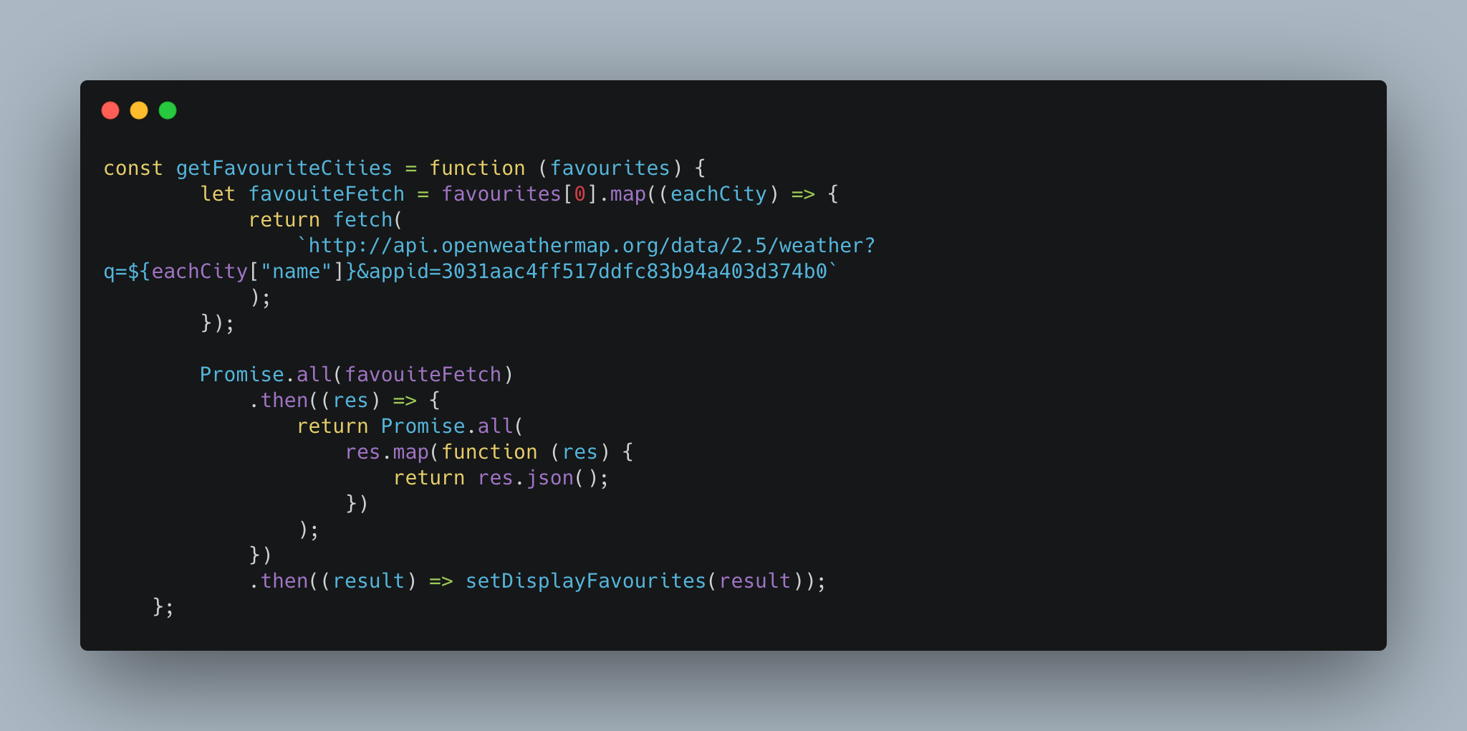
Favourite Code
Weather cont 37 to 53

Slide 8
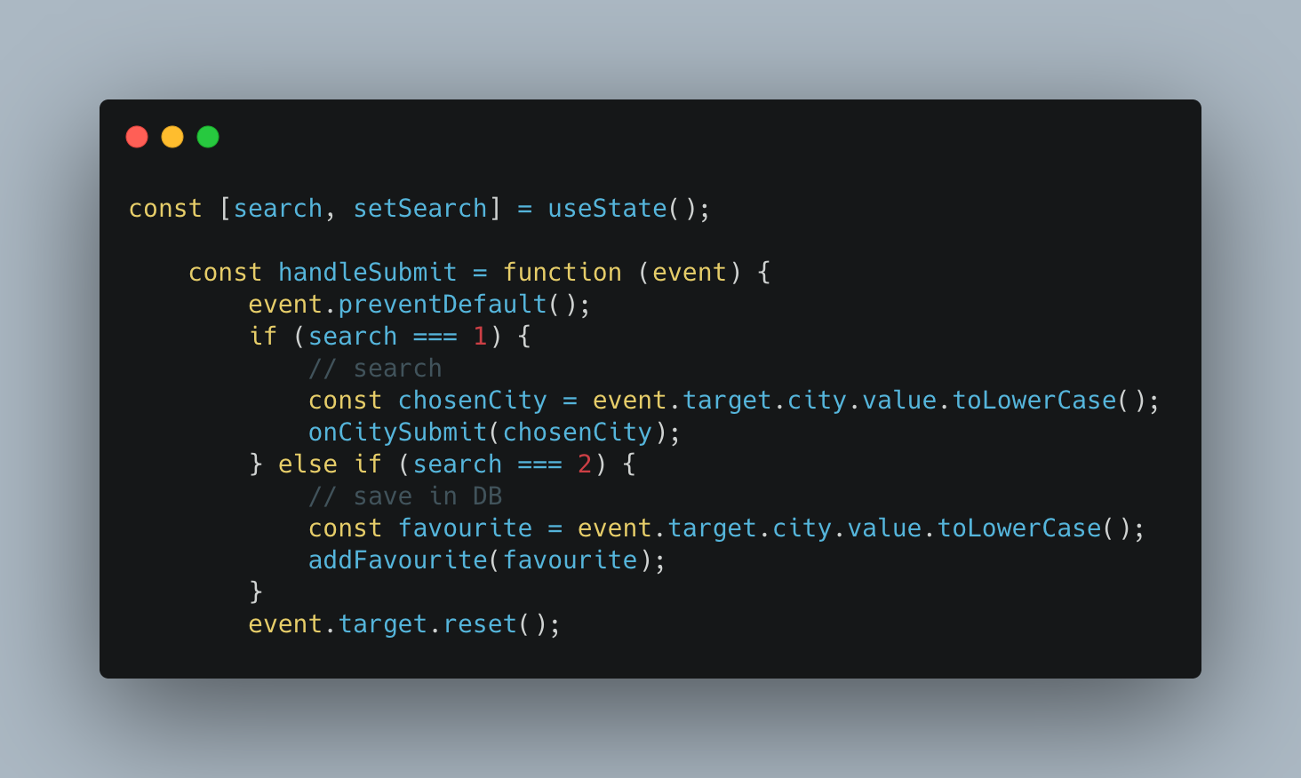
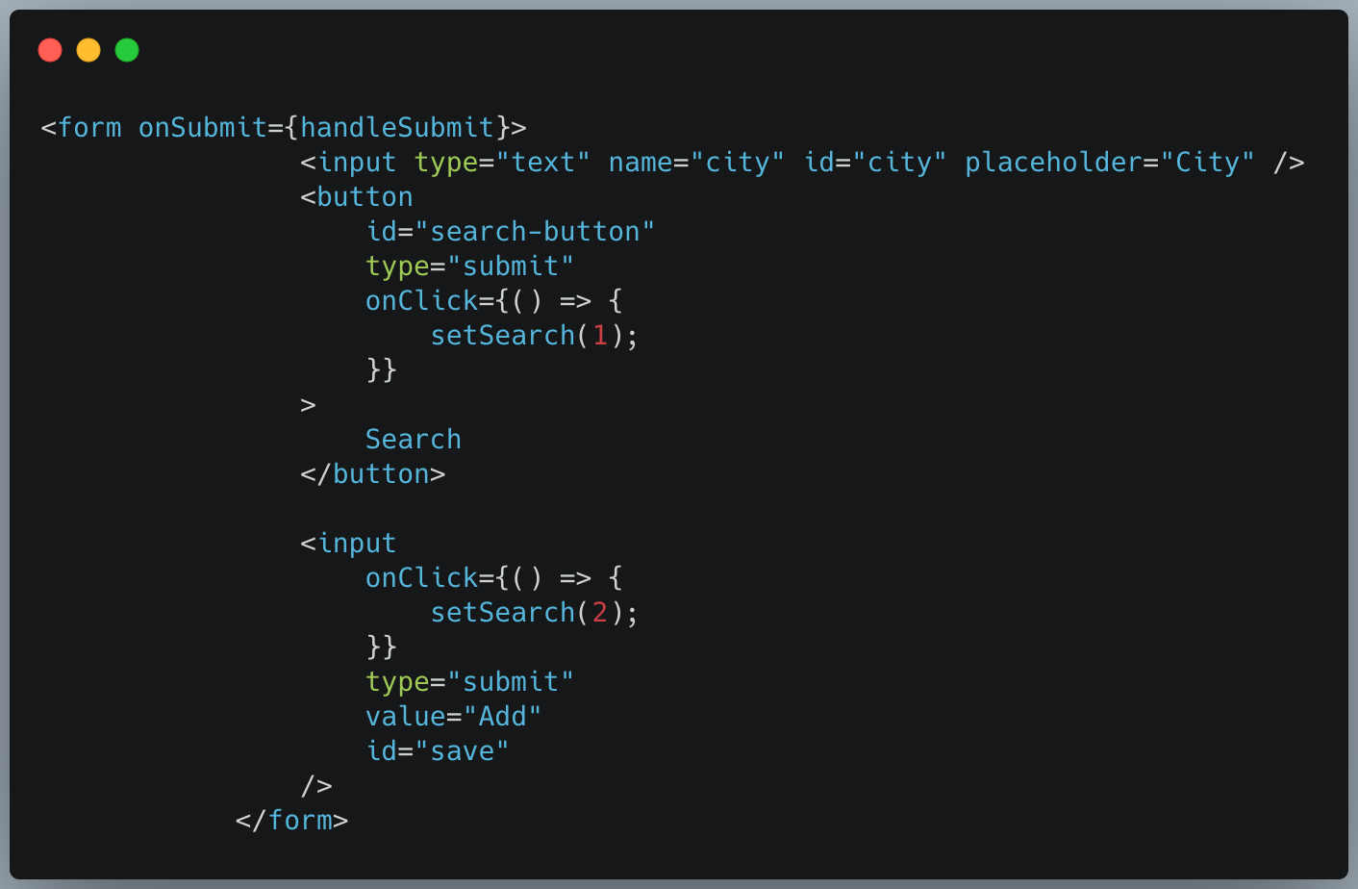
Favourite Code

Slide 9
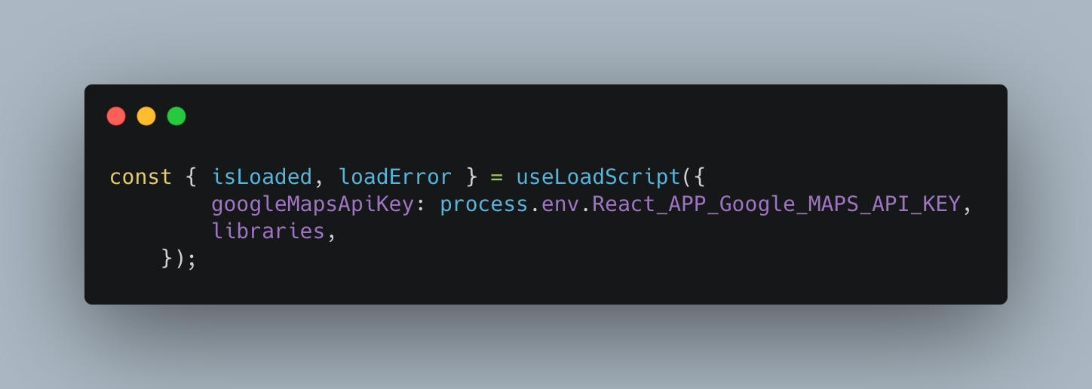
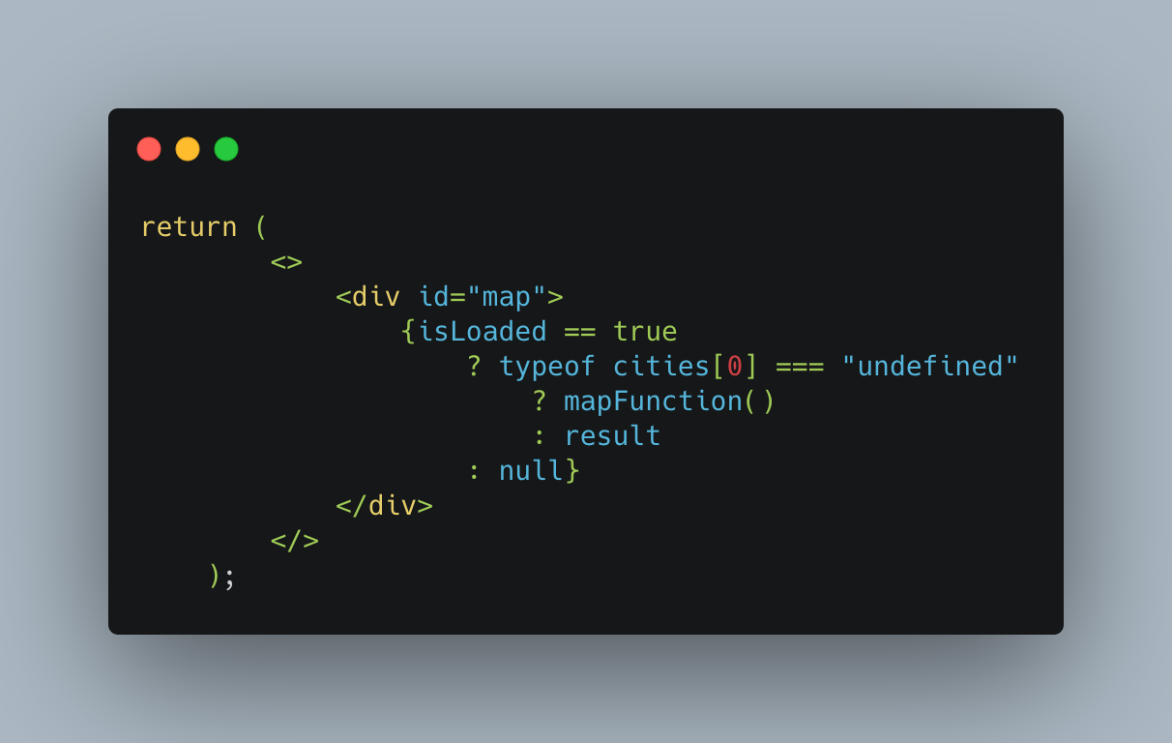
Interesting Bug
Ukmap 60 to 70 and 13 to 16

Slide 10
Main Learning Points
Take more time to plan the structure with components and containers and that they make sense for building upon with future functionality
Have everyone involved in basic app
  Get basic app up and running first
  Split people up to tackle different features
Communication is key
  Check in regularly to ensure everyone is working towards the same end point

